Slide 1
RAILWAY RESERVATION SYSTEM​
Project Member :
Ms. Anugiraha
Ms. Deepa
Ms. Gopika
Ms. Kamaleeshvari
Ms. Sivaranjini
Ms. Vinodhini
Guided By :
Prof. Indrakka Mali​​

Slide 2
Contents :
Introduction
ER Diagram
Working of Back-End
Working of front-end
Annotations
APIs
Features Of System
Software Requirement
Conclusion

Slide 3
Introduction :
Railway Reservation System helps booking tickets for train , The Railway Reservation System is a Java Spring Boot, MySql and Angular Project which can on the tomcat server.
We have majorly two main roles in the application. One is the Admin whose responsibility is to manage the whole application like adding product, adding train information, view booking, etc.
Another user is the who will book tickets using the application

Slide 4
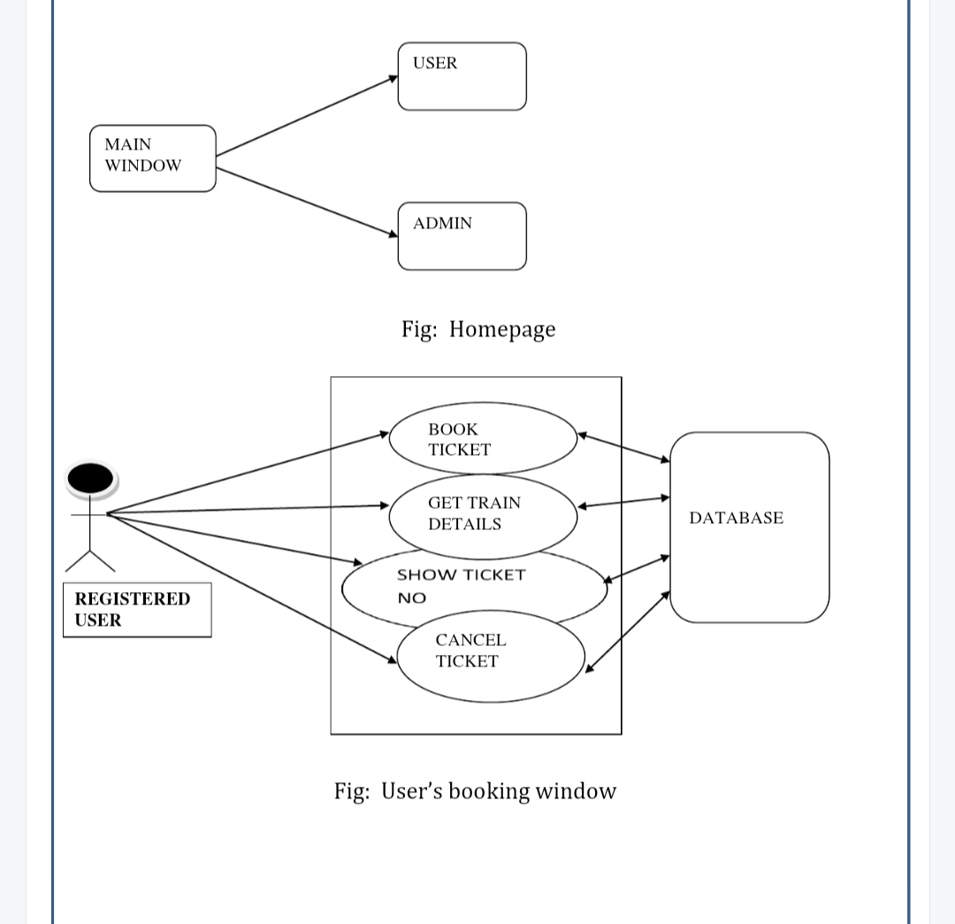
ER Diagram:

Slide 5
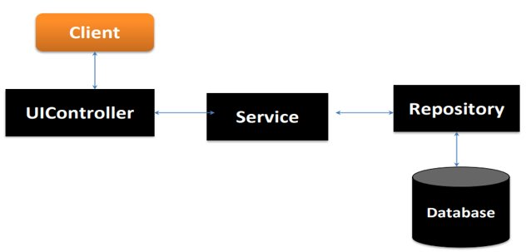
Working Of Back-End :
There are mainly three stages

Slide 6
WORKING OF FRONT-END
Railway Reservation system which implements the MVC(Model-View-Control)Architecture. As View, Angular-8 with routing is used . For the backend, Spring Boot v2.1.6 is used.
Java persistence Api (JPA) is used to write the Business Logic. REST Api’s are Written to communicate between server ports (Angular->port:4200, SpringBoot ->port:8080, MySql -> port:3306)
The project consist of a Login and Register page when user navigate to localhost:4200. On successfull login or registration as a user, a welcome page all the user detail and option to booking your ticket.

Slide 7
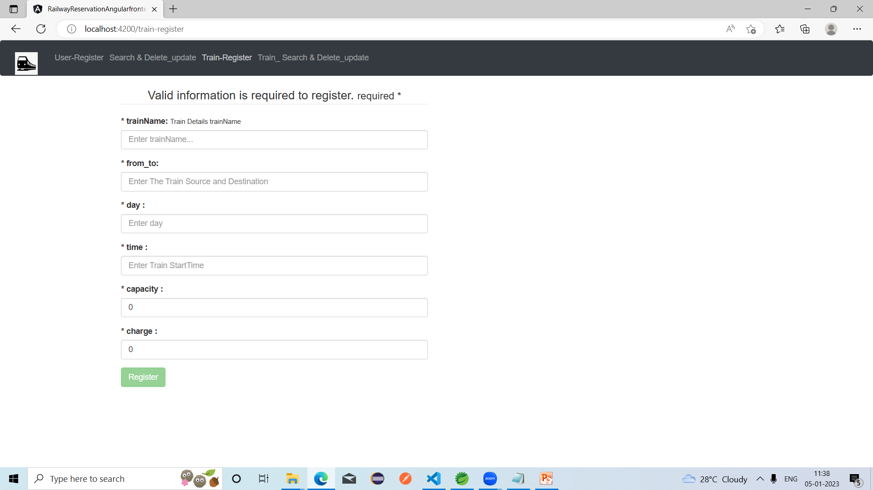
Train-Register

Slide 8
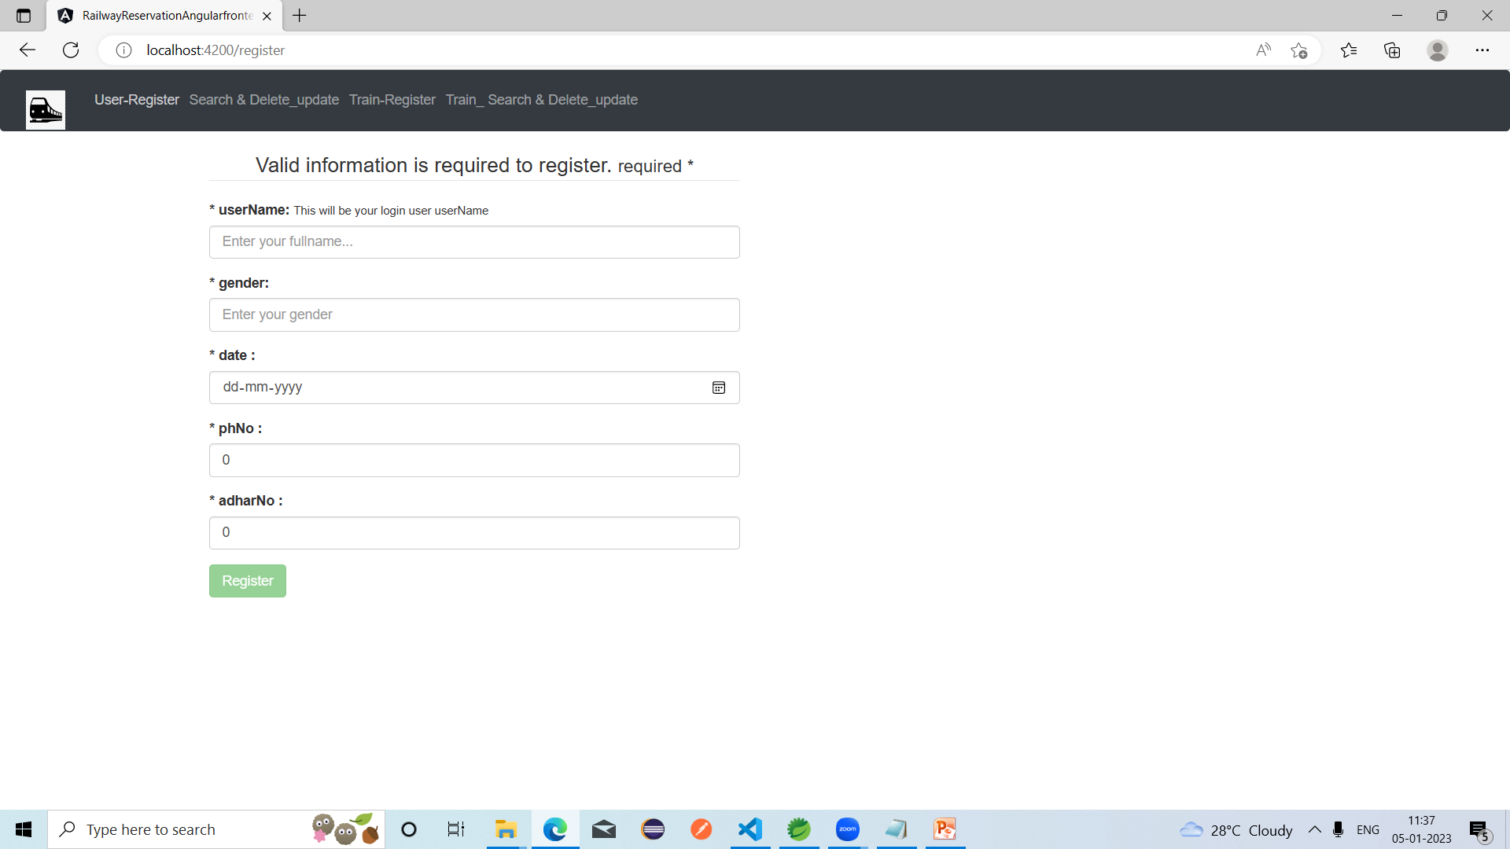
User-Register

Slide 9
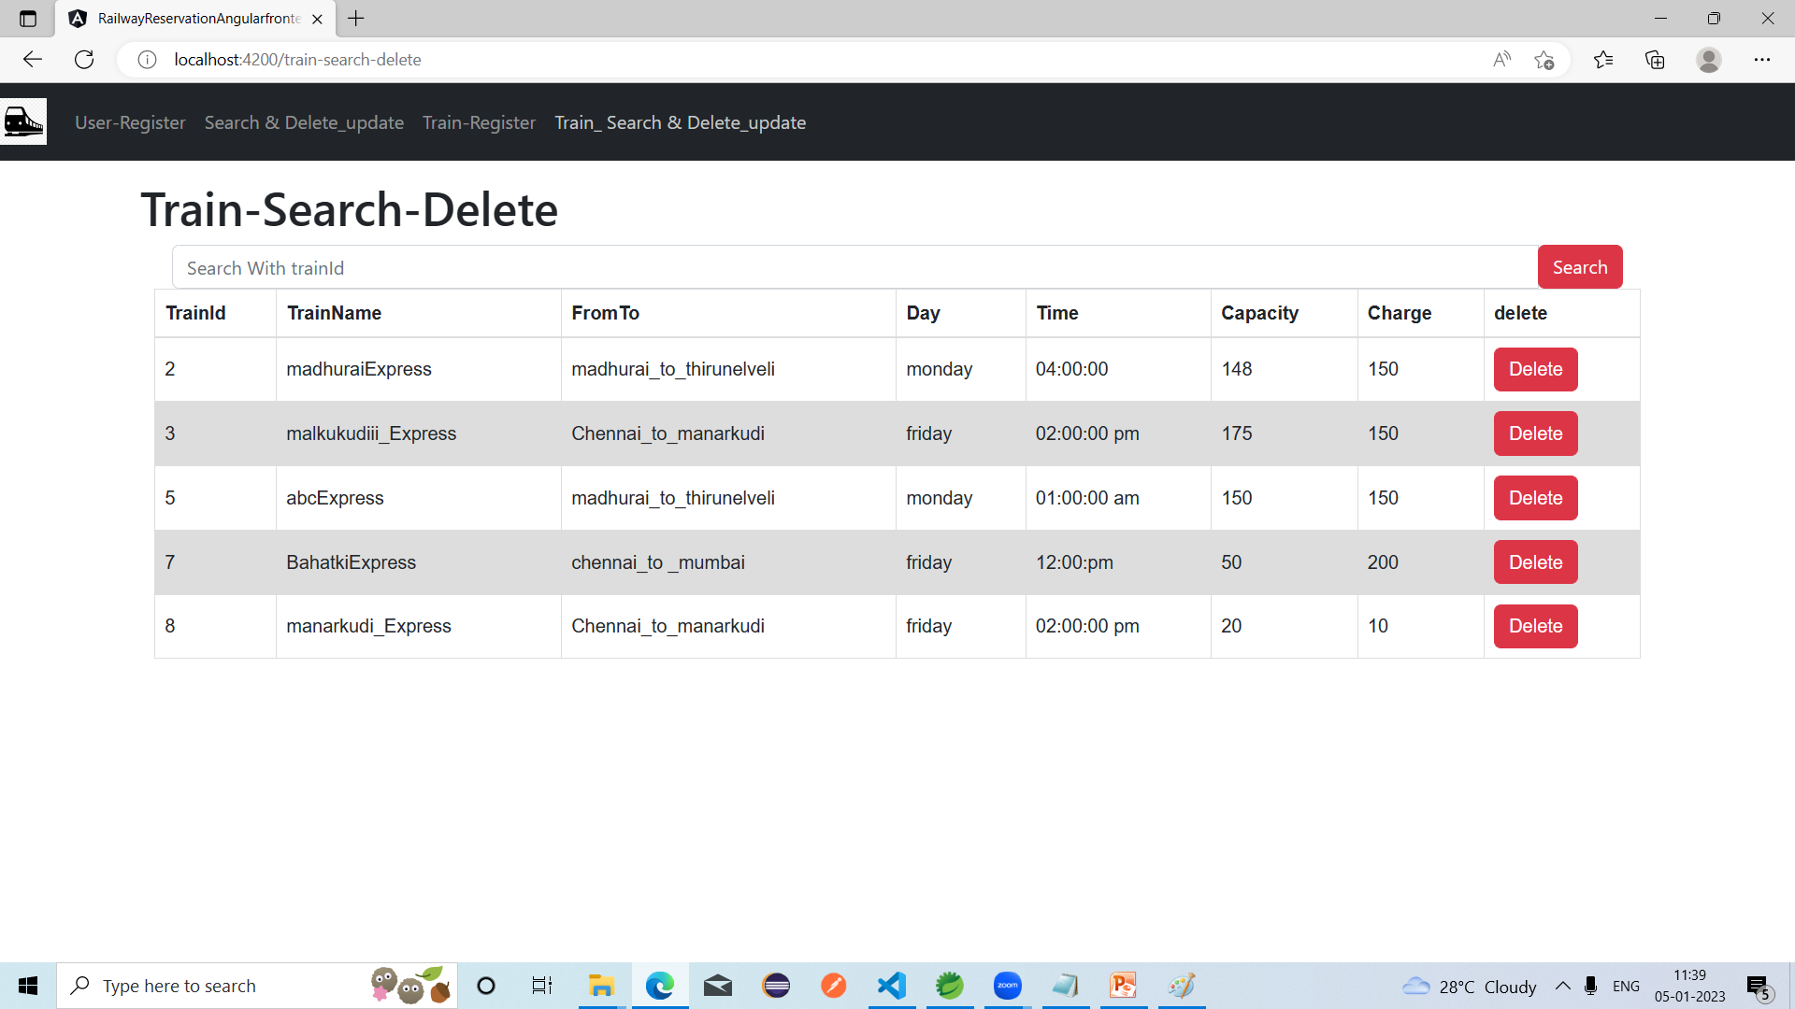
Train-Search-Delete

Slide 10
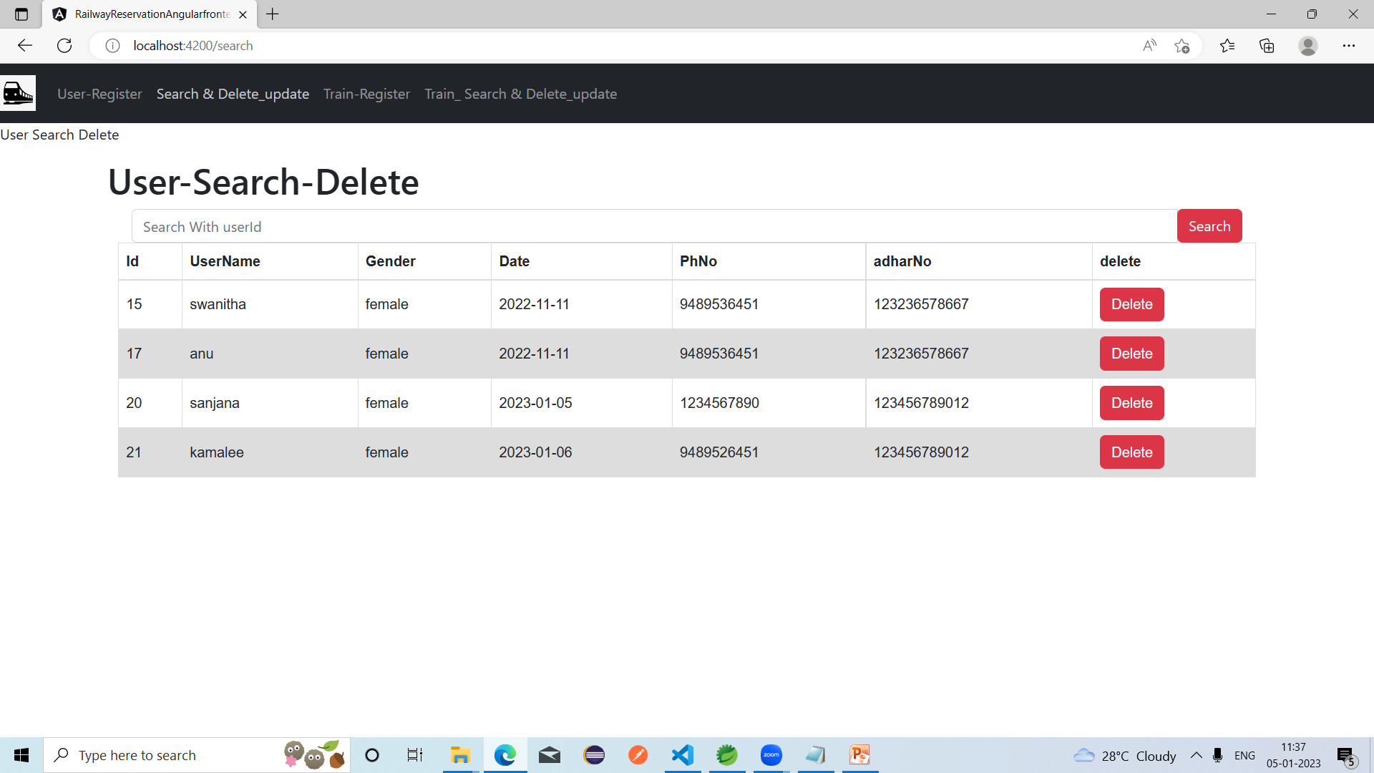
User-Search-Delete

Slide 11
Work Flow :
Client send a request to server for different options like inserting ,fetching ,update and delete a data.
When client hit on request .Request goes to the Controller Class and use respective URL to take data.
Then control of URL goes to the service Class And Conditions get Executed.
For returning response to client use same sequence. Service To Controller Class.
Here Repository class is used to interact with database using Hibernate Technology.

Slide 12
Annotations (@) :
Annotations are used to provide supplemental information
about a program.
Annotations start with ‘@’.
@Id : This id annotation is used to declare attribute as primary key.
@GeneratedValue : Used to generate value automatically when user insert new record in table.
3. @Not Empty : used for validation.

Slide 13
4. @Email : used to compare email format ​.​
5. @size : Used in collection. ​
6. @NotNull : This gives mandatory filed to enter data.​
8. @ManyToOne : To create the many-to-one relationship between the user and train class.​
9. @JoinColumn : helps us specify the column we'll use for joining.
10. @JsonIgnore : Is used to ignore the logical property used in serialization and deserialization.​
11. @Entity : is used to mark this class as an Entity bean.​
​

Slide 14
12. OneToMany : is used to create the one-to-many relationship between the train class and user ​.
13. Cascadetype.All : ensure that all persistence events such as persist, refresh, merge and remove that occur on the parent, will be passed to the child.​
14. @override : Informs the compiler that the element is meant to override an element declared in a superclass.​
15. @RestController : This annotation is used at the class level and allows the class to handle the requests made by the client.​
16. @Autowired : Enables you to inject the object dependency implicitly.​

Slide 15
17. @ControllerAdvice : Allows to handle exceptions across the whole application in one global handling component.​​
18. @ExceptionaHandler : Used to handle the specific exceptions and sending the custom responses to the client.​
19. @Service : It is used to mark the class as a service provider
20. @Notnull : It is used to makes entity as not null.
21. @Max : Max is used to validation to show the max value.
22. @Repository : Repository is used in repository interface.
23. @Query : Its declares finder queries directly on repository methods.

Slide 16
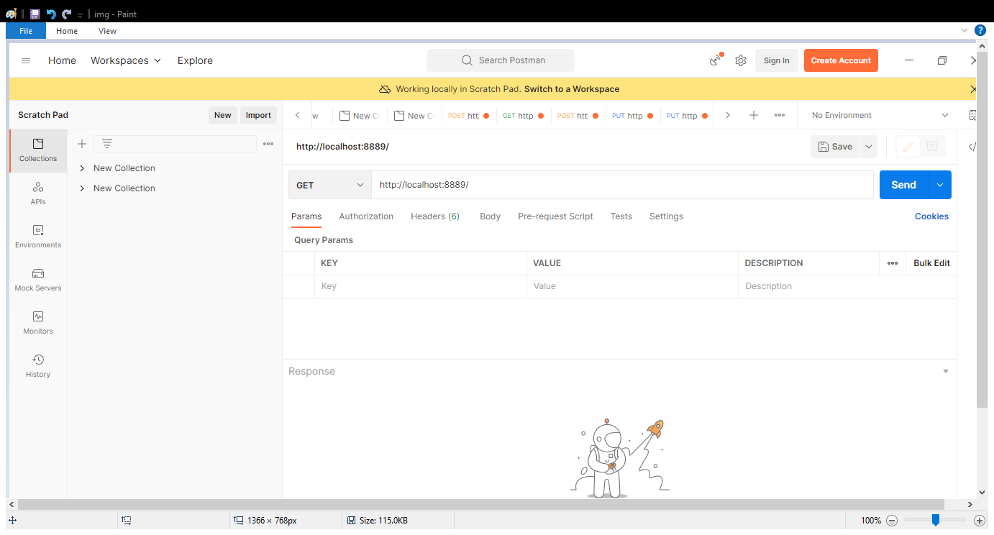
Application Programming Interface(APIs);
APIS Under Admin To Do :
“Admin/all/” : Direct can access all train details using this URL.

Slide 17
Train Api:
@PostMapping("/trains")
@GetMapping("/trains/{trainid}")
@GetMapping("/findAll")
@DeleteMapping("/trains/{trainid}")
@PutMapping("/Trains/{trainId}")
@GetMapping("/trains/trainname/{trainName}")
@GetMapping("/trains/trainCapacity/{trainId}")

Slide 18
User Api:
@PostMapping("/user")
@GetMapping("/user{uid}")
@ResponseBody
@PutMapping("/userTickettBooking/{userId}/trains/{trainId}")
@DeleteMapping("/delete/{id}")

Slide 19
Train URL:
1. “post/train” : To add the train details in table.
2. “get/train” : we can get all train record which is in train table.
3. “delete/train/train id” :​ It is used to delete particular record in table to use trained.
4. “put/train/trained” : It is to update particular train by trainid.
5. “get/train/trainid” : This url is to get a particular train by using trainid.
6. “get/train/name” : Its used to get particular train by its name.
7. “/get/traincost” : This url for to calculate the train cost.

Slide 20
user URL :
“post/user” : It used for for to add user in table.
“get/user” : This url for getting all user record in the table.
“delete/user/userid” : Its for deleted particular record in the table.
“put/user/userid” : Its for update a particular user in existing table.

Slide 21
5. “put/train/trainid/user/userid” : It is assign to particular user to particular train bases on their the relation.
6. “get/user/userid” : It is for get particular user by using subjectid.
7. “get/user/name” : It is for the get particular user by its name.

Slide 22
Software & hardware used :
Software Requirements :
Operating System : Windows 7 10
Language : Java
IDE : Spring Tool Suite
Client : Postman
Backend : MySQL
Hardware Requirements :
CPU : Intel Pentium V processor
RAM : 6 GB or above
Hard Disk : 64 GB hard disk space or minimum

Slide 23
Conclusion :
The project entitled as Railway Reservation System. The web application involes almost all the features of the online train ticket booking.
The future implementation will be online help for the customer and chatting with website administrater.
This project is successfully implemented with all the features mentioned in system requirements specification.
Finally with a secured connection the Railway Reservation successfully without any interruptions.

Slide 24


